Slide 1


Slide 2
Ensembling FTW: BOOSTING METHODS

Slide 3
Boosted ensemble methods (Gradient Boosted Trees, AdaBoost, XGB, LIGHTGBM…)
Tree-based boosting methods are the most common.
They work sequentially: a small tree (sometimes called a stump) is created and used to make predictions, then the next step focuses on getting the problematic examples right and this procedure is applied iteratively. They are multi-stage estimators.
There are two main schools of thought:
1. Update weights of each example (AdaBoost)
2. Update loss function (GBTs & friends)
Also, the ensembling can combine different stage-estimators with non-uniform weights.

Slide 4
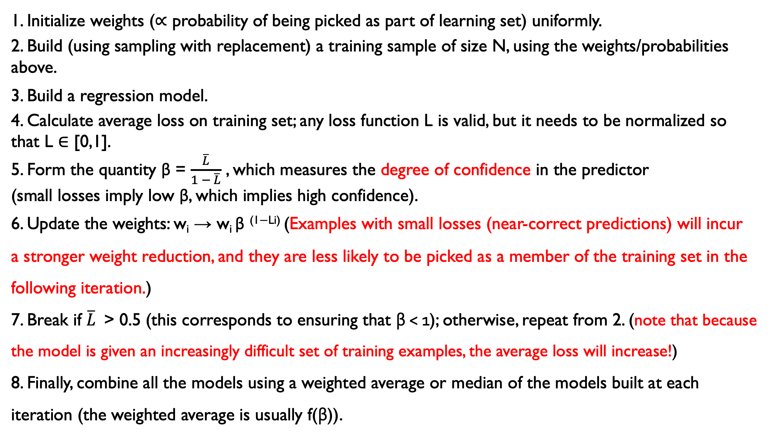
AdaBoost (Adaptive Boosting) pseudo-code
1. Initialize weights (∝ probability of being picked as part of learning set) uniformly.
2. Build (using sampling with replacement) a training sample of size N, using the weights/probabilities above.
3. Build a regression model.
4. Calculate average loss on training set; any loss function L is valid, but it needs to be normalized so that L ∈ [0,1].
5. Form the quantity β = $\frac{\overline{L}}{1 − \overline{L}}$ , which measures the degree of confidence in the predictor
(small losses imply low β, which implies high confidence).
6. Update the weights: w_{i} → w_{i} β ^{(1−Li)} (Examples with small losses (near-correct predictions) will incur
a stronger weight reduction, and they are less likely to be picked as a member of the training set in the following iteration.)
7. Break if $\overline{L}$> 0.5 (this corresponds to ensuring that β < 1); otherwise, repeat from 2. (note that because the model is given an increasingly difficult set of training examples, the average loss will increase!)
8. Finally, combine all the models using a weighted average or median of the models built at each iteration (the weighted average is usually f(β)).

Slide 5
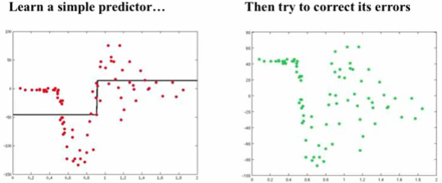
Gradient Boosted Trees
Simple idea:
1. Start with a weak learner (e.g. 1-split tree) and fit a model F to data y: F₁(x) = y
2. Calculate residuals (i.e., where model is failing) F₁(x) – y and make model h(x) that fits the residuals
3. Update model: F₂(x) = F₁(x) + h(x)
4. Repeat from 1, until convergence
Example credit: Alexander Ilher

Slide 6
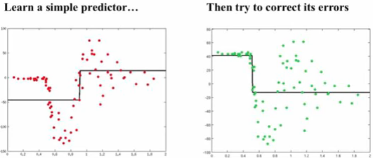
Gradient Boosted Trees
Simple idea:
1. Start with a weak learner (e.g. 1-split tree) and fit a model F to data y: F₁(x) = y
2. Calculate residuals (i.e., where model is failing) F₁(x) – y and make model h(x) that fits the residuals
3. Update model: F₂(x) = F₁(x) + h(x)
4. Repeat from 1, until convergence
Example credit: Alexander Ilher

Slide 7
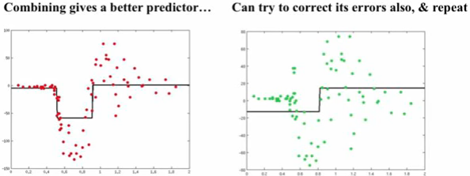
Gradient Boosted Trees
Simple idea:
1. Start with a weak learner (e.g. 1-split tree) and fit a model F to data y: F₁(x) = y
2. Calculate residuals (i.e., where model is failing) F₁(x) – y and make model h(x) that fits the residuals
3. Update model: F₂(x) = F₁(x) + h(x)
4. Repeat from 1, until convergence
Example credit: Alexander Ilher

Slide 8
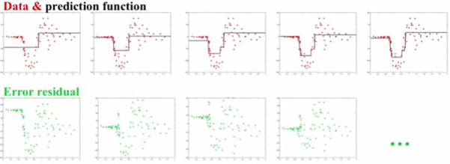
Gradient Boosted Trees
Simple idea:
1. Start with a weak learner (e.g. 1-split tree) and fit a model F to data y: F₁(x) = y
2. Calculate residuals (i.e., where model is failing) F₁(x) – y and make model h(x) that fits the residuals
3. Update model: F₂(x) = F₁(x) + h(x)
4. Repeat from 1, until convergence
Example credit: Alexander Ilher

Slide 9

Let’s put the “Gradient” in GBM
The general idea of “Gradient Descent” is that the most efficient way to minimize a function is to move in the direction of the loss function’s negative gradient.
If we want to minimize the loss function, we can fit a model iteratively to its negative gradient components.
In fact, fitting the residuals works because the residuals are the derivative of the mean square error function.

Slide 10
Let’s put the “Gradient” in GBM
Modified idea to work with any differentiable loss function L:
Initialize F to median of y
Calculate pseudo-residuals = - dL/dF
Fit model to pseudo - residuals, h(x)
Make new model: F₂(x) = F₁(x) + α* h(x) (α = learning rate)
Repeat from 2, until convergence
The learning rate is a parameter of boosted models (shrinkage).
Small α values require larger # of iterations but often gives better predictions
α can be chosen on a step-by-step basis and becomes the weight of each predictor in the final ensemble.

Slide 11
Questions: - do you think that GBT will work even with weak base learners? - do you think that they are more likely to overfit or underfit?

Slide 12
Issues with GBT: very easy to overfit → regularization is needed!
Regularization can be applied in various ways:
Shrinkage: We can choose a small value (< 1) for the coefficient η, also known in sklearn as learning rate, which regulates the contribution of each new correction to the current model. A GBT model with smaller values of η will take longer to achieve the same accuracy; there is a trade-off between the number of iterations and the learning rate.
Subsampling: We might select a random fraction of the data (with or without replacement) in order to fit each step. The smaller the fraction, the stronger the regularization.
Random feature selection: We might use only a random subset of features at each step. This randomization technique is “borrowed” from bagging algorithms such as Random Forests, where it is similarly used to reduce the variance of the single estimator.

Slide 13
What can you use Bagging/Boosting methods for?
Both classification and regression problems!
You can also always turn a classification problem into a regression problem by predicting a probability that on object belongs to a certain class
They are an all-purpose, generally fast and accurate sets of algorithms
For tabular data (where you don’t need to learn a representation, i.e., you are satisfied with your original feature space), often the best method out there (see this thread)

Slide 14
Variable importance
A cool feature of tree-based methods is that it is easy to build an understanding of which features carry the majority of the relevant information.
The most common method is to
sum the impurity reduction at all tree nodes where each variable appears,
then rank features in order from larger to smaller decrease of impurity.

Slide 15
Variable importance
A variable is most important if it leads to a large Mean Decrease of Impurity (in other words, it has a large impact on the performance).
Feature ranking can be used to gain understanding of the data and to reduce the size of a data set (for example, one can feature-rank the original data set and picked the first x out of y features, using information loss as a guidance).
Cool example:
Here!

Slide 16
Too good to be true?
Yes.
High cardinality features tend to be picked more often, because they have more “capacity”. It took me a while to understand this issue; reading this helped.
The feature importance is calculated using the training data. If the model overfits, we can’t trust the ranking (the model could be just picking up a lot of noise).
Highly correlated features will “split” the importance (this is the bane of my existence as an Astrophysicist!)
Solution for 1: permutation-based feature importance (the decrease in a model score when a single feature value is randomly shuffled).
Solution for 2: use not the most performant model, but a robust (low-bias) model for the FI.
Solution for 3: Do clustering on highly correlated features to pick the centroid feature and then do feature importance. I am applying it right now to SED fitting problem, and it seems to work 🥳 Also see Dalya’s suggestion on stripping correlation (probably useful for few-feature case)

Slide 17
FEATURE IMPORTANCE WITH OTHER ALGORITHMS?
It is possible!
If computational power is not an issue, my favorite method is:
Start from all features and compute cross-validated score
Do the same for all combinations of N-1 features; discard feature that makes the smallest difference
Continue iteratively
Another option (if computational power is an issue) is to start from one feature and build up the model (considering N+1 features at each step)
SHAP values work in a similar manner

Slide 18
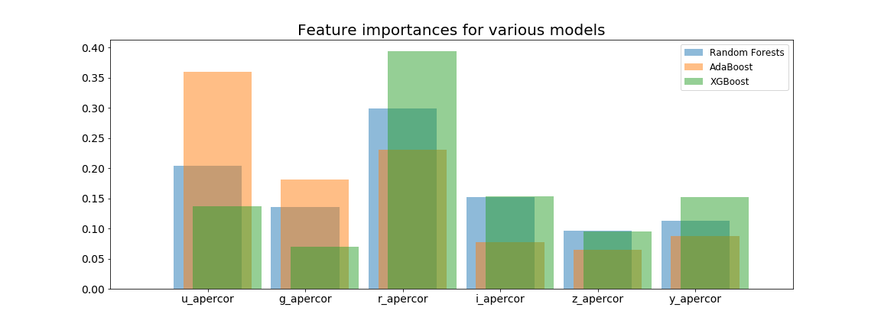
ARE feature importances algorithm-dependent?
BUT OF COURSE!
This example shows the feature importance derived for the photometric redshift problem for three ensemble methods.
Take-home point: you can use these methods to discard unimportant features quite safely, but take the ranking with a huge grain of salt.

Slide 19
References / Further Reading
On Random Forests:
Gilles Louppes Ph. D. thesis (Random Forests: from Theory to Practice)
arXiv preprint arXiv:1407.7502
Jake VanDerPlas, the Python Data Science Handbook, “In depth: Random Forests”
On Boosted Trees:
https://www.youtube.com/watch?v=sRktKszFmSk
https://www.gormanalysis.com/blog/gradient-boosting-explained/
https://medium.com/mlreview/gradient-boosting-from-scratch-1e317ae4587d
or (https://nbviewer.jupyter.org/github/groverpr/Machine-Learning/blob/master/notebooks/01_Gradient_Boosting_Scratch.ipynb) not sure of original source…
On Interpretability tools: I made a short document that may be a useful starting point.

Slide 20



Plug (but maybe not shameless?)
I recorded a free online course on ML for Physics and Astronomy, sponsored by Flatiron’s CCA.
It follows the textbook I am writing now revising wrote published (out in e-book, in print on 8/15), but the book is not required!
It has videos, quizzes, and notebooks with learning check-ins, all courtesy of team “Javioli” (right)
Now working on the Spanish version with some amazing students and postdocs (the AstroMaquinarios): Lucia Perez, Rosario Cecilio-Flores, Manuel Pichardo Picano, Genaro Suarez
Check out
the course:
Yes, PhotoBooth still exists.
From left: Jake Postiglione, me, and Olga Privman
Order
the book:

